Slide 1
Technical Communication

Slide 2



Lead-in
Suppose you’ve just bought a household appliance that is new to you, how would you learn to use it?

Slide 3
Writing Instructions & Manuals

Slide 4
1
Writing Instructions
A
Defining Instructions
B
Designing a Set of Instructions
目 录
CONTENTS
C
Planning for Safety
D
Drafting Effective Instructions
E
Revising, Editing and Proofreading
2
Writing Manuals

Slide 5
Defining Instructions
Instructions are process descriptions written to help readers perform a specific task.
explain how to do something
explain how something happens
Readers of a process description want to understand the process.
Readers of instructions want a step-by-step guide to help them perform the process.
Effective instructions are based on writing good descriptions.

Slide 6
Designing a Set of Instructions
When designing a set of instructions, you need to consider a number of issues related to document design and page design.
What are your readers’ expectations?
For instructions that accompany a simple, inexpensive product, readers will expect instructions written on the back of the package or, at most, printed in black and white on a small sheet of paper folded inside the package.
For instructions that accompany an expensive consumer product, readers will expect a more sophisticated full-color document printed on high-quality paper.

Slide 7
Do you need to create more than one set of instructions for different audiences?
complex devices such as air-conditioners
a set of instructions for electricians (who will install and maintain the device)
a set of instructions for homeowners (who will operate the device)
a paper-based document that can also be read easily on the Internet
a brief video of the tasks you describe

Slide 8
What languages should you use?
in two or more languages to communicate with more people and avoid legal problems
simultaneous design—a multi-column page
One column presents the graphics, and each of the other columns presents all the information in one language.
It won’t work when there are more than two languages.
It is efficient as the graphics are presented only once.
sequential design—all the information is presented in one language after another.
It is easier for readers to use because they are not distracted by the text in other languages.
The graphic have to be presented more than once, making the instructions longer.

Slide 9
Will the environment in which the instructions are read affect the document design?
outdoors, →use a coated paper that can tolerate a little water
in a small, enclosed area, →select a small size of paper and a binding that allows the reader to fold the pages over to save space
with a lot of room, →create poster-size（海报） instructions that can be taped to the wall and that are easy to read from across the room

Slide 10
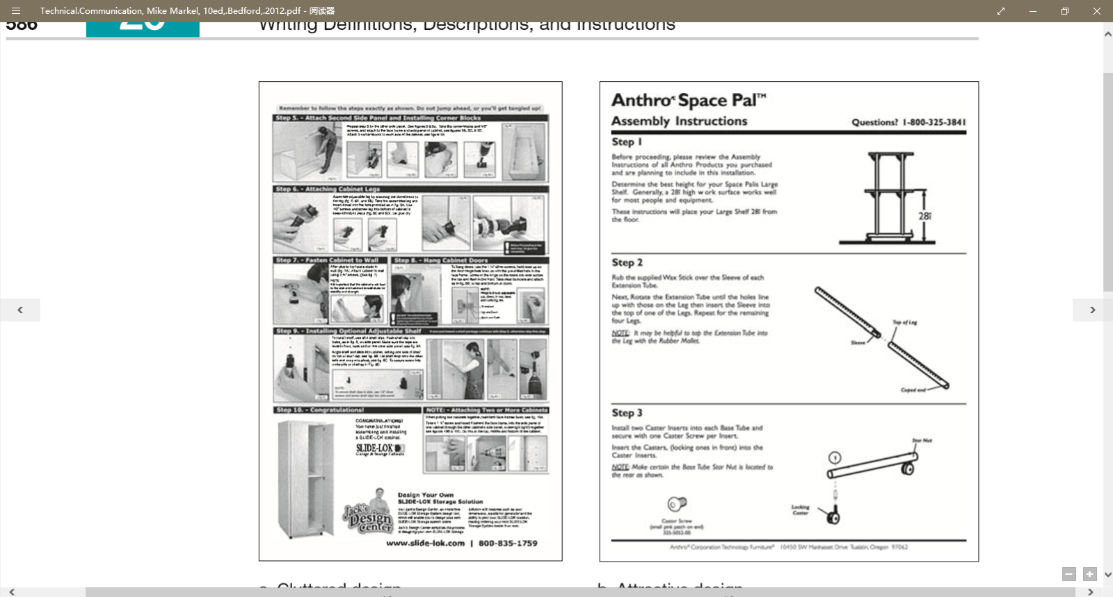
Which one do you think is clear and attractive?

Slide 11
Will readers be intimidated by the information?
Don’t squeeze too much information onto the page.
Build in space for wide margins and effective line spacing, use large type, and chunk the information effectively.
Present graphics to accompany every step or almost every step.
Create a design that makes it clear which graphics go with each text passage.
separate the text and graphics for one step from the text and graphics for the next step with a horizontal rule or extra line spacing.

Slide 12
Planning for Safety
What is our most important responsibility when the subject we are writing about involves safety risks?
do everything we can to ensure our readers’ safety.
The best way to keep our readers safe is to be honest and write clearly.
If the readers will encounter safety risks, explain what those risks are and how to minimize them.
Protecting our readers’ safety is
a question of rights
Readers have a right to the best information they can get.
a question of law
People who get hurt can sue the company that made the product or provided the service.

Slide 13
When writing safety information, be clear and concise; avoid complicated sentences.
complicated
It is required that safety glasses be worn when inside this laboratory.
You must wear safety glasses in this laboratory.
Wear safety glasses in this laboratory.
simple
Sometimes a phrase works better than a sentence.
Safety Glasses Required.

Slide 14



Four most important signal words
What are the four important signal words that indicate the seriousness of the advice?
Note
These three signal words are accompanied by symbols showing the color combinations endorsed by ANSI.

Slide 15
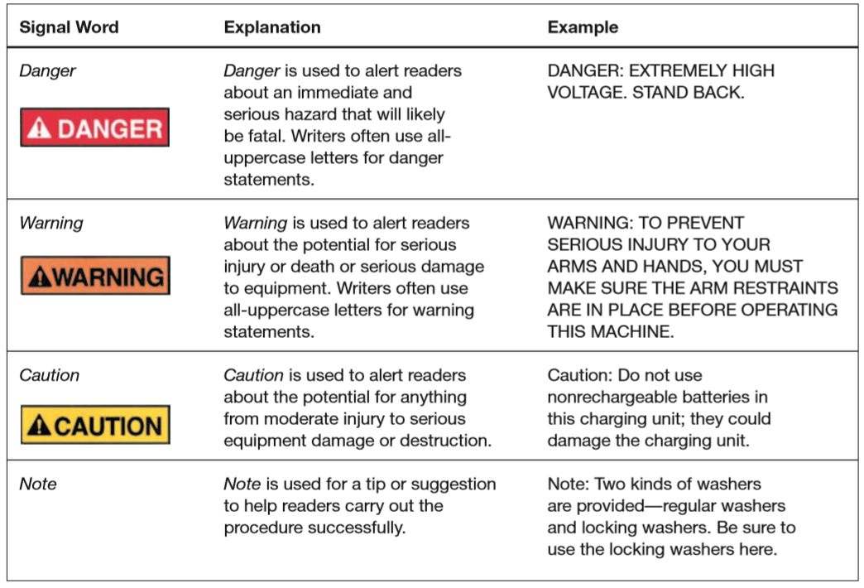
Notes:
1918年，美国材料试验协会（ASTM）、与美国机械工程师协会（ASME）、美国矿业与冶金工程师协会（ASMME）、美国土木工程师协会（ASCE）、美国电气工程师协会（AIEE）等组织，共同成立了美国工程标准委员会（AESC）。美国政府的三个部（商务部、陆军部、海军部）也参与了该委员会的筹备工作。 1928年，AESC改组为美国标准协会（ASA）。1966年8月，又改组为美利坚合众国标准学会（USASI）。1969年10月6日改成现名：美国国家标准学会（ANSI）。

Slide 16

A typical safety label that incorporates both ANSI and ISO standards
The Danger signal word and the text are consistent with the ANSI approach
words
The yellow triangle is consistent with the ISO approach
icons
Whether the safety information is printed in a document or on machinery or equipment, it should be prominent and easy to read.
Notes:
ISO=International Organization of Standardization

Slide 17
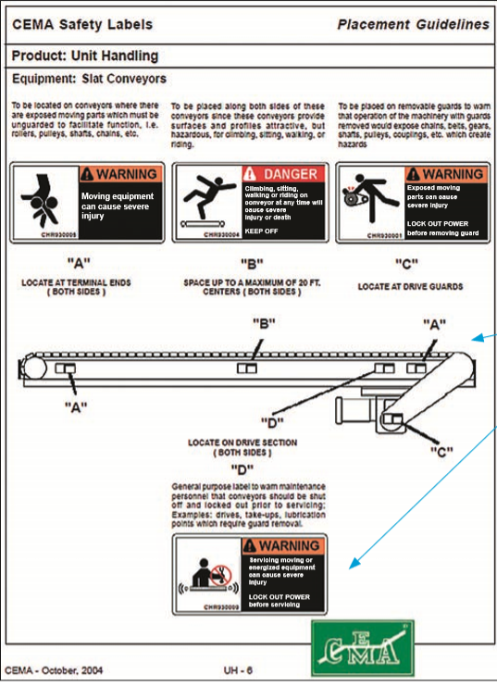
Where should the safety information be placed on machinery or equipment?
Part of planning for safety is determining the best location for the safety information.
no easy answer because you cannot control how your audience reads your document.
Put safety information wherever you think the reader is likely to see it, and don’t be afraid to repeat.
A reasonable amount of repetition is effective.

Slide 18
Drafting Effective Instructions
Instructions can be brief (a small sheet of paper) or extensive (up to 20 pages or more).
Regardless of the size of the project, most instructions are organized like process descriptions.
The main difference: the conclusion of a set of instructions is not a summary but an explanation of how to make sure readers have followed the instructions correctly.
Most set of instructions contain four elements:
a title
step-by-step instructions
a general introduction
a conclusion

Slide 19
Drafting Titles
simple and clear
Two common forms:
How-to: “How to install the J112 Shock Absorber”
Gerund: “Installing the J112 Shock Absorber”
Avoid the noun string: “J112 Shock Absorber Installation Instructions”
awkward and difficult for readers to understand

Slide 20
Drafting General Introductions
The general introduction provides the preliminary information readers will need to follow in the instructions safely and easily.
Who should carry out this task?
Why should the reader carry out this task?
When should the reader carry out this task?
What safety measures or other concerns should the reader understand?
What items will the reader need?
List necessary tools, materials, and equipment needed
How long will the task take?
Consider stating how long the task will take readers with no experience, some experience, and a lot of experience.

Slide 21
Drafting Step-by-Step Instructions
Number the instructions.
For long, complex instructions, use two-level numbering.
Use the imperative mood.
More direct and economical than the indicative mood.
Avoid the passive voice.
Present the right amount of information in each step.
Do not confuse steps and feedback statements.
A step is an action that the reader is to perform.
“Insert the disk in the drive.”
A feedback statement describes an event that occurs in response to a step.
“The system will now update your user information.”
Present the feedback statement as part of the step to which it refers.

Slide 22

Drafting Step-by-Step Instructions
Include graphics.
When appropriate, add a photograph or a drawing to show the reader what to do.
Do not omit articles (a, an, the) to save space.
Omitting articles can make the instructions unclear and hard to read.
“Locate midpoint and draw line”
The reader cannot tell if “draw line” is a noun or a verb and its object.

Slide 23
Read, Comment and Revise
Start the engine and run it to idling speed while opening the radiator cap and inserting the measuring gauge until the red ball within the glass tube floats either to the acceptable green range or to the dangerous red line.
Overloaded information
Start the engine.
Run the engine to idling speed
Open the radiator cap.
Insert the measuring gauge.
Determine whether the red ball within the glass tube floats to the acceptable green range or up to the dangerous red line.

Slide 24

Read and Comment
1. Mix one part cement with one part water, using the trowel. When the mixture is a thick consistency without any lumps bigger than a marble, place a strip of the mixture about 1’’ high and 1’’ wide along the face of the brick.
1. Pick up the trowel.
1. Mix one part cement with one part water, using the trowel, until the mixture is a thick consistency without any lumps bigger than a marble.
2. Place a strip of the mixture about 1’’ high and 1’’ wide along the face of the brick.
Too much information
Too little information
Right amount of information

Slide 25
Drafting Conclusions
Instructions often conclude
by stating that the reader has now completed the task
by describing what the reader should do next.
Now that you have replaced the glass and applied the glazing compound, let it sit for at least five days so that the glazing can cure. Then, prime and paint the window.
Some conclusions end with maintenance tips or a troubleshooting guide.
A troubleshooting guide, usu. presented as a table, identifies common problems and explains how to solve them.

Slide 26
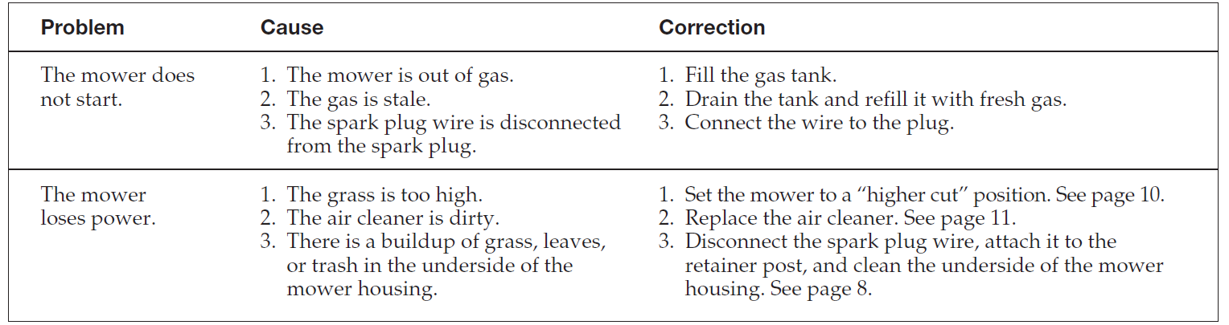
Excerpt from a Troubleshooting Guide

Slide 27
Revising, Editing, and Proofreading Instructions
Revise, edit and proofread all the documents to make sure they are honest, clear, accurate, comprehensive, accessible, concise, professional in appearance, and correct.
When you write instructions, you should be extra careful for two reasons:
Your readers rely on your instructions to carry out the task.
If they can’t complete it or they do complete it, but the device doesn’t work correctly, they’ll be unhappy.
Your readers rely on you to help them complete the task safely.
To prevent injuries—and liability actions—build time into the budget to revise, edit, and proofread the instructions carefully.
If possible, carry out usability testing on the instructions.

Slide 28
Writing Manuals
There is no absolute distinction between a set of instructions and a manual.
The two share a main purpose: to explain how to carry out a task safely, effectively, and efficiently.
A manual includes much of the same sort of information found in a set of instructions.
A set of instructions is typically shorter and more limited in its subject.
Manuals tend to be longer and more involved than instructions.
Both kinds of documents can include safety information.
A manual is likely to include some sections not found in set of instructions.
A manual typically has a title page.
The main difference between the two is that a manual has more elaborate front matter and back matter.

Slide 29
Front matter.
The introduction, sometimes called a preface, often contains an overview of the contents, frequently in the form of a table, which explains the main contents of each section and chapter.
It also contains a conventions section, which explains the typography of the manual.
It also might include a where to get help section, referring readers to other sources of information, such as the company’s Web site and customer-support center.
It might contain a section listing the trademarks of the company’s own products and those of other companies.

Slide 30
Back matter.
Manuals typically include
a set of specifications of the device or system,
a list of relevant government safety regulations and industry standards that the device or system supports,
tips on maintenance and servicing the device,
a copyright page listing bibliographic information about the manual,
an index.
Many manuals also include glossaries which define unfamiliar terminology.

Slide 31
Organizations work hard to make their instructions and manuals appropriate for multicultural readers.
You need to answer three important questions as you plan the documents：
In what language should the information be written?
You can either translate the document into the reader’s native language or use Simplified English with a limited grammar and vocabulary to make it easy to understand.
Do the text or graphics need to be modified?
You need to be aware of cultural differences.
Left hand in the US vs. left hand in the Middle East
What is the readers’ technological infrastructure?
If your readers don’t have Internet access, there is no point in making a Web version of the information.

Slide 32
Questions for review
Are the instructions designed effectively, with adequate blank space and a clear relationship between the graphics and the accompanying text?
Do the instructions have a clear title?
Does the introduction to the set of instructions
state the purpose of the task?
describe safety measures or other concerns that readers should understand?
list necessary tools and materials?
Are the step-by-step instructions
numbered?
expressed in the imperative mood?
simple and direct?
Are appropriate graphics included?
Does the conclusion
include any necessary follow-up advice?
include, if appropriate, a troubleshooting guide?

Slide 33
Thank You for Attention！

